Slide 1
Artificial Intelligence-Introduction
Jaya Sil
Professor
Dept. of Computer Science & Technology
IIEST, Shibpur

Slide 2
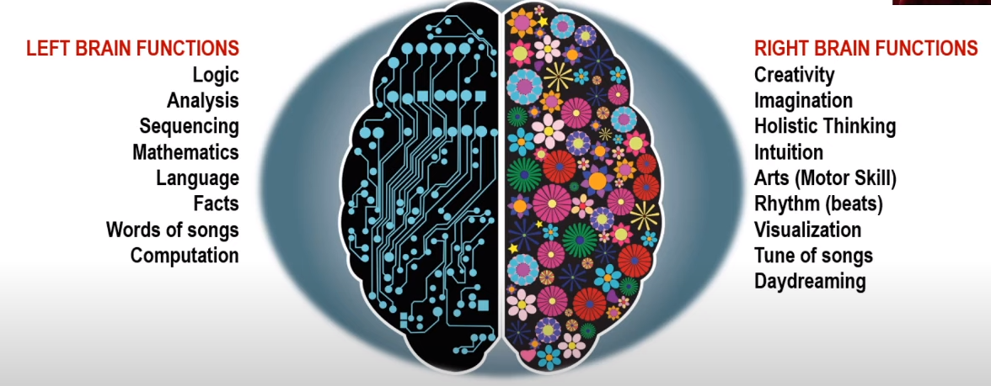
Cognitive System of Human
Classical AI
Modern AI: Convergence of these two
Statistical Methods, Machine Learning
Stuart Russell, Peter Norvig, Artificial intelligence : A Modern Approach, Prentice Hall, Fourth edition, 2020.

Slide 3
Motivations
AI is not just a technical subject, but it has relation with Philosophy.
AI subject consisting of many sub-fields.
AI based problems have many solutions.
Breadth wise course not depth (Something of Everything)
Tradeoff between Broad and Shallow vs. Deep and Narrow.
Searching, heuristic search, planning, decision making, Reinforcement Learning.
Theory → Modeling → Algorithm → Applications

Slide 4
History
Take a real life problem, convert it into a computational problem, i.e. Modeling
For finding solution, apply suitable algorithms for the problem.
ENIAC is the first computer (1946) following principle of Turing Machine, used for US defense purposes.
Lot of progress of AI has done due to Defense
Question: “Can a machine think?” – Alan Turing in 1950
Not known if the machine cannot communicate with us by any way.
Brain is meaningless in absence of communicators.

Slide 5
Turing Test
The Turing Test is a method of inquiry in artificial intelligence (AI) for determining whether or not a computer is capable of thinking like a human being.
The test is named after Alan Turing, the founder of the Turing Test.
The phrase “The Turing Test” is most properly used to refer to a proposal made by Turing (1950) as a way of dealing with the question whether machines can think.
According to Turing, the question whether machines can think is itself “too meaningless” to deserve discussion.
To pass a well-designed Turing test, the machine must use natural language, reason, have knowledge and learn.

Slide 6
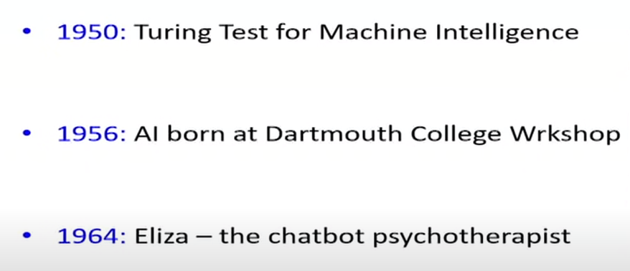

McDermott
1974-1980 no development on AI
Next Expert systems were developed but not sustained.
1997 – AI ends human supremacy in Chess

Slide 7
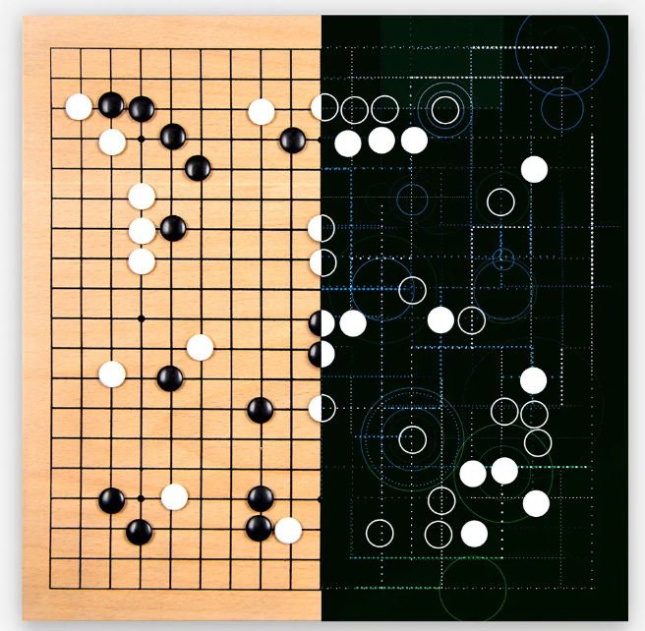
Phase of AI
First Phase – Logic based AI
Second Phase – Probabilistic AI
Third phase – Neural Network based AI
AlphaGo competition
Go (game) is an abstract strategy board game for two players in which the aim is to surround more territory than the opponent.
Go---a 2,500-year-old game that's exponentially more complex than chess.
Researchers at DeepMind---a self-professed "Apollo program for AI" that Google acquired in 2014---staged this machine-versus-man contest in October, in London.
In A MAJOR breakthrough for artificial intelligence, a computing system developed by Google researchers in Great Britain has beaten a top human player at the game of Go.

Slide 8
Introduction
Artificial intelligence is the simulation of human intelligence processes by developing computing systems that have the ability to perform tasks like human.
AI is the study of ideas that enable computers to be intelligent.
Applications of AI include Expert System, Natural Language Processing, Speech Recognition, Robotics and Machine Vision.
AI can process large amounts of data much faster and make predictions more accurately than humanly possible.
AI is expensive to process the large amounts of data.

Slide 9
Areas of AI and Some Dependencies
Knowledge Representation
Search
Logic
Machine Learning
Planning
Expert Systems
NLP
Vision
Robotics

Slide 10
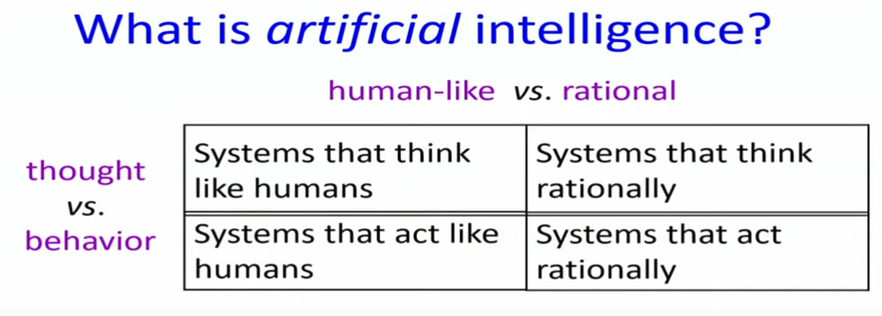


We don’t do cost benefit analysis, rather decision is intuitive

Slide 11
Systems that think ‘rationally’
Humans are not always ‘rational’
How to define Rationale - Rationale means doing the right thing
The right thing is expected to maximize goal achievement, given the available information
Is it in terms of logic?
Logic can’t express everything (e.g. uncertainty)
At that time, some specific (in domain) human knowledge or information is used, thus covers more generally different situations of problems.
AI is the study of mental facilities through the use of computational models (Charniak and McDermott).
“The study of the computations that make it possible to perceive, reason, and act” (Winston)

Slide 12
Systems that act Rationally
Study AI as rational agent –
2 advantages:
It is more general than using logic only
Because: LOGIC + Domain knowledge
It allows extension of the approach with more scientific methodologies
AI has two major roles:
Study the intelligent part concerned with humans.
Represent those actions using computers.

Slide 13
Systems that act like humans
Natural language processing
for communication with human
Knowledge representation
to store information effectively & efficiently
Automated reasoning
to retrieve & answer questions using the stored information
Machine learning
to adapt to new circumstances

Slide 14
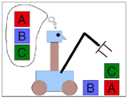
Goals of AI
To make computers more useful by letting them take over dangerous or tedious tasks from human.
Understand principles of human intelligence

Slide 15
The Foundation of AI
Mathematics formalizes the three main area of AI: computation, logic, and probability
Computation leads to analysis of the problems that can be computed
complexity theory
Probability contributes the “degree of belief” to handle uncertainty in AI
Decision theory combines probability theory and utility theory (bias)
Psychology
How do humans think and act?
The study of human reasoning and acting
Provides reasoning models for AI
Strengthen the ideas
humans and other animals can be considered as information processing machines

Slide 16
The Foundation of AI
Computer Engineering
The power of computer makes computation of large and difficult problems more easily
AI has also contributed its own work to computer science, including: time-sharing, the linked list data type, OOP, etc.
Linguistics
For understanding natural languages
different approaches has been adopted from the linguistic work
Formal languages
Syntactic and semantic analysis
Knowledge representation

Slide 17
The main topics in AI
Artificial intelligence can be considered under a number of headings:
Search (includes Game Playing).
Representing Knowledge and Reasoning with it.
Planning.
Learning.
Expert Systems.
Natural language processing.
Interacting with the Environment (e.g. Vision, Speech recognition, Robotics)

Slide 18
The main topics in AI
Artificial intelligence can be considered under a number of headings:
Search (includes Game Playing).
Representing Knowledge and Reasoning with it.
Planning.
Learning.
Natural language processing.
Expert Systems.
Interacting with the Environment (e.g. Vision, Speech recognition, Robotics)

Slide 19
Search
Search is the fundamental technique of AI.
Possible answers, decisions or courses of action are structured into an abstract space, which we then search.
Search is "blind" and “informed":
blind
we move through the space without worrying about what is coming next, but recognising the answer if we see it
informed
we guess what is ahead, and use that information to decide where to look next.
We may want to search for the first answer that satisfies our goal, or we may want to keep searching until we find the best answer.

Slide 20
Knowledge
Declarative
Procedural
Declarative knowledge deals with factoid questions (what is the capital of India? Etc.)
Procedural knowledge deals with “How”
Procedural knowledge can be embedded in declarative knowledge

Slide 21
Planning
Given a set of goals, construct a sequence of actions that achieves those goals:
often very large search space
but most parts of the world are independent of most other parts
often start with goals and connect them to actions
no necessary connection between order of planning and order of execution
what happens if the world changes as we execute the plan and/or our actions don’t produce the expected results?

Slide 22
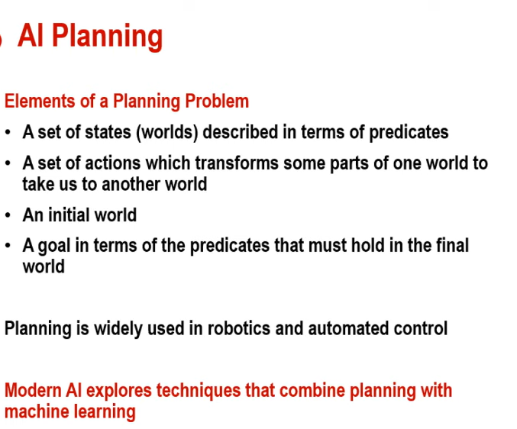

Slide 23
Learning
If a system is going to act truly appropriately, then it must be able to change its actions in the light of experience:
how do we generate new facts from old ?
how do we generate new concepts ?
how do we learn to distinguish different situations in new environments ?

Slide 24
Interacting with the Environment
In order to enable intelligent behaviour, we will have to interact with our environment.
Properly intelligent systems may be expected to:
accept sensory input
vision, sound, …
interact with humans
understand language, recognise speech, generate text, speech and graphics, …
modify the environment
robotics

Slide 25
Knowledge and Inferences
Several ways to know:
Empiricism: Involves acquiring knowledge through observations or experiences.
The Scientific method: A process of systematically collecting and evaluating evidence to test ideas and answer questions.
Intuitions: Rather than examining facts or using rational thoughts, intuition involves believing what feels true.
Authority: Accepting ideas because some authority figure says that they are true.
Rationalism: Using Logic and Reasoning to acquire knowledge
Reasoning = Making Inference

Slide 26
Logical Reasoning
What is known to reason about something that is not known explicitly.
Deduction : From a given set of facts infer another fact that is necessarily true – cause to effect (disease to symptoms)
Abduction: From a given set of facts infer another fact that is possibly true – Effect to cause (symptoms to disease).
Abduction needs to be consistent.
Abduction is the guess work.
Induction: From a given set of facts infer a new fact.
Known as generalization.
Recognizing that a number of entities in the domain share some common property, and assert as a general statement.

Slide 27
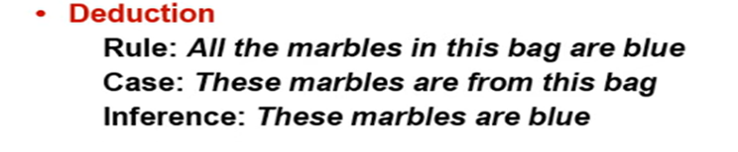


Automated Reasoning

Slide 28
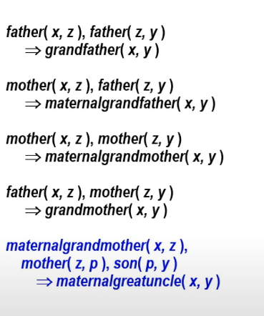
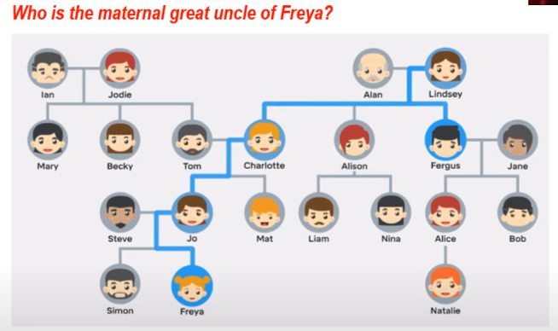

Logical Reasoning

Slide 29
Problem Solving
An autonomous agent has a goal to achieve by choosing a set of actions.
Abductive inference suggests what action is best.
Background knowledge make some strategies and tactics where knowledge comes through training.
Abductive inferences generate expectations.
Scientific progress begins with Abduction (looking for causes) and Induction (making informed Generalization).
Gets validated by Deduction
Gets experimental Validation
Only Induction adds New Knowledge.

Slide 30
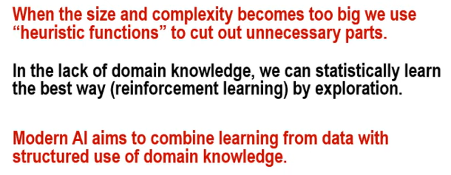
Constraint optimization problem

Slide 31
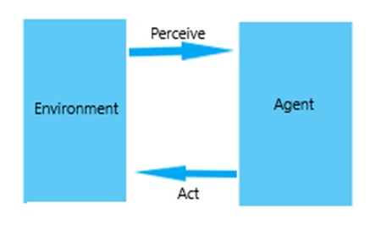
Agent and Environment
Artificial intelligence studies the whole system by dividing it into two components:
Agent
Environment
An agent can either perceive information from the environment or can perform some actions on the environment.
Agent
The system which is responsible for acting on the environment and causing any changes to it is called an agent.
It first perceives the information by observing the environment and then acts according to the particular scenario.
An agent is the one which should be designed in such a way that it may interact from its surroundings by itself, i.e. it should not require any user input to feed information into it.
It should be able to understand the situation, find the best decision that could be taken, and then act according to it.

Slide 32
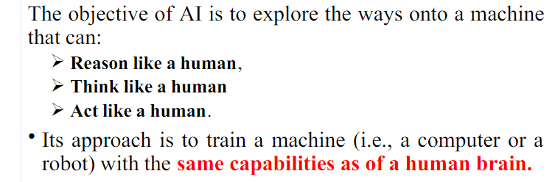

Slide 33
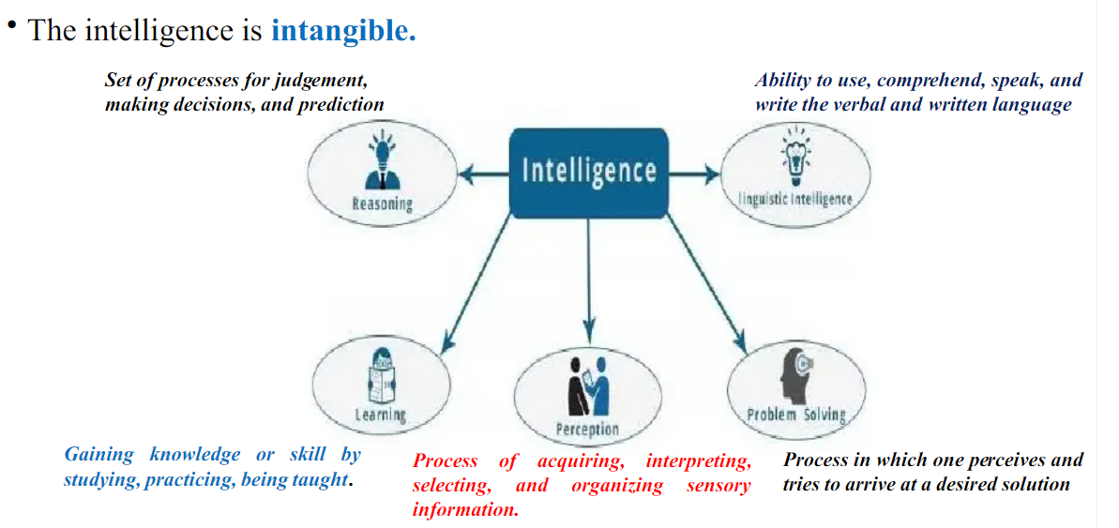

Slide 34
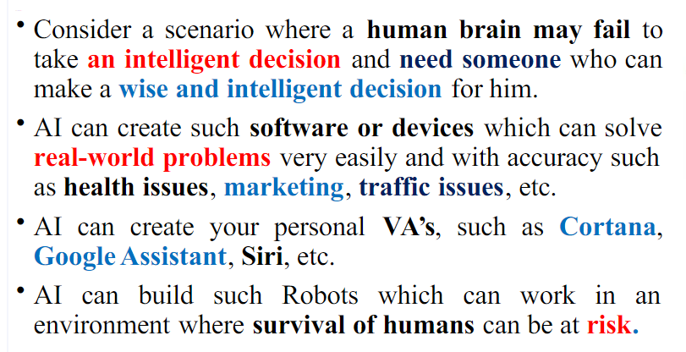

Slide 35
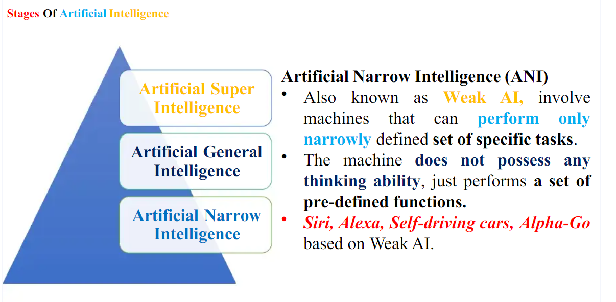

Slide 36
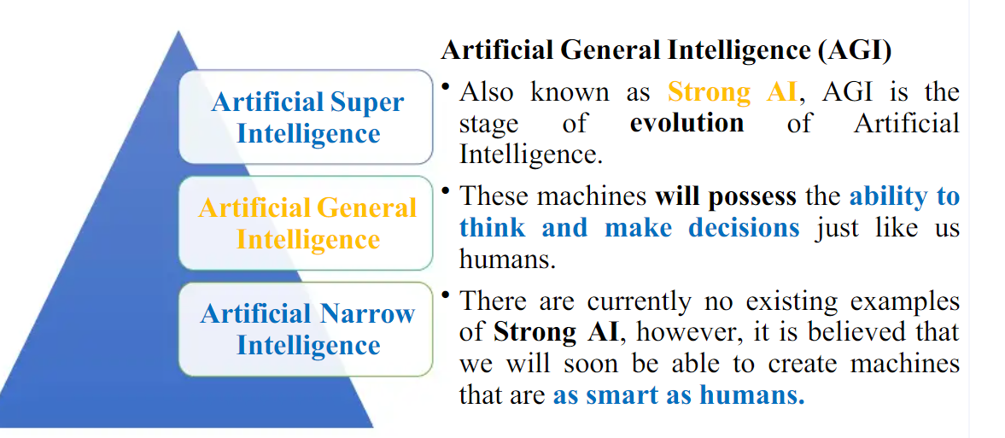

Slide 37
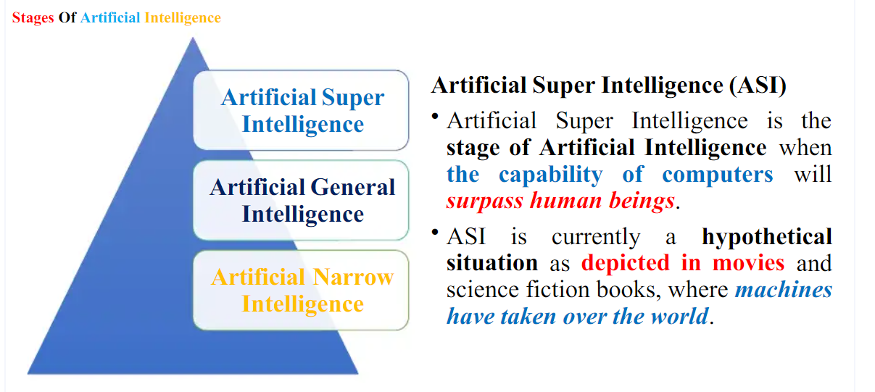

Slide 38
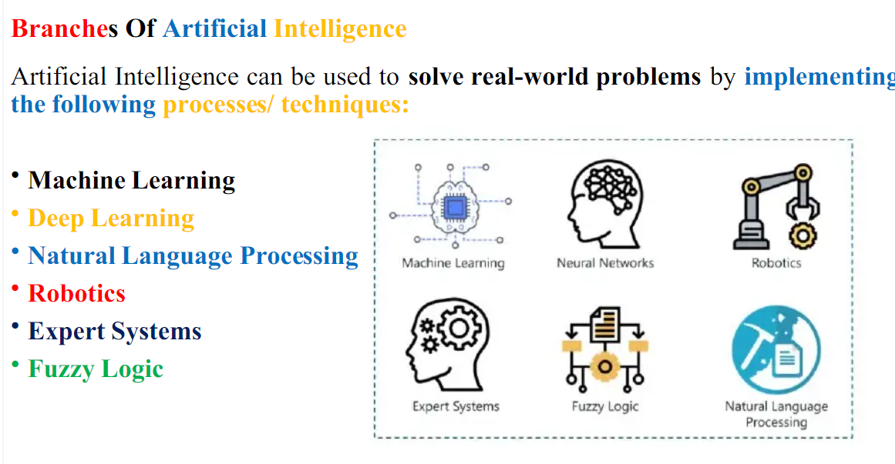

Slide 39
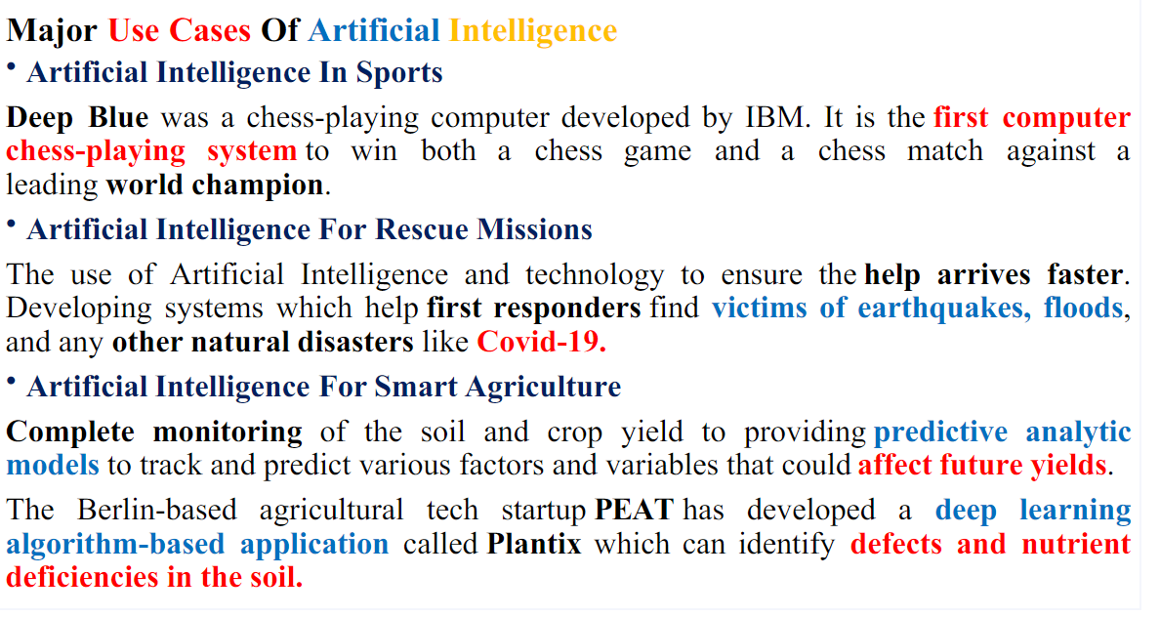

Slide 40
